Slide 1
Recent results on the symmetry energy from GANIL
Probing the Symmetry energy in fission
&
dissipative reactions
Chbihi
GANIL
Why studying E_{sym} in Fission
Extracting E_{sym} from isotopic distribution of FF
Influence of neutron evaporation
Application to fission data (VAMOS + Spider)
Application to more dissipative reactions (VAMOS+INDRA)

Slide 2
Why studying Esym in binary fission
Process of fission
Low energies :
  eliminate the pre-equilibrium emission
Strongly constrained by mass and charge conservation :
  most part of the system is contained in the 2 fission fragments (Ztot ≈ Z1+Z2)
Facilitate the experimental extraction of E_{sym}
Extend the fission study to more complicated cases: dissipative reactions and multifrgamentation

Slide 3



W.A. Friedman prescription
Isotopic yield & isoscaling in fission
Maximum of the isotopic distribution : 1st derivative of BE
z1/a1 = z2/a2 = Z/A
Dominant term (n-z)²/a
Width of the isotopic distribution : 2d derivative
W.A. Friedman PRC 29, 031601R 2004

Slide 4
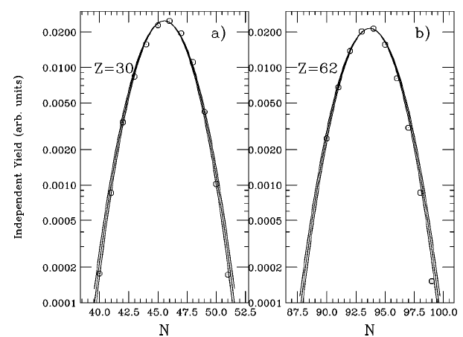
Test of the method
Fission fragments of ²³⁴U
http://ie.lbl.gov/fission.html
T = 1.7, 1.8, 1.9 MeV

Slide 5
Test of the method
Peak position: shift of 1 u (1 neutron), whole LDM
C_{sym} = 23 MeV, shifted by + 0.75 (Z=30) & 2. (Z=62)
From this Eq. we can deduce the symmetry energy term if the width of the isotopic yield distribution is known :

Slide 6
GEneral Fission Model GEF http://www.cenbg.in2p3.fr/-GEF,354-
We use the general Fission Model GEF, developed by B. Jurado and K.-H. Schmidt, in order to generate a data set of fission fragments induced by the excitation of 250Cf at E* = 50 MeV.
Then we fitted the isotopic distributions with a Gaussian functional and applied the Friedman Eq. as :

Slide 7
GEF, fission of ²⁵⁰Cf @ E* = 50 MeV, isotopic distribution before neutron evaporation
The temperature is deduced from the E*
assuming Fermi gas with a=A/8 (T= 1.24 MeV)
One can observes that Esym = 20-25 MeV, < Esym> = 23 MeV
An increase of Esym aroud Z_{FF} = 53 and 39

Slide 8
GEF, fission of ²⁵⁰Cf, post n, after neutron evaporation
Esym is reduced to 19 MeV for Z_{FF} = 30 and to 11 MeV for 64
An increase of Esym around Z_{FF} = 54 and 37

Slide 9
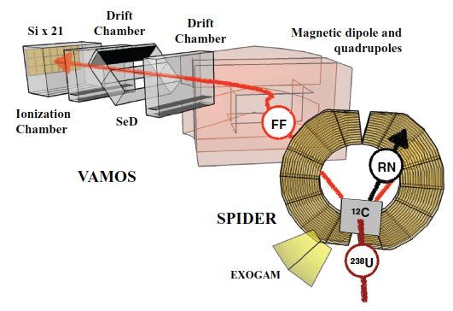
Experiment
M. Caamaño et al., PRC88, 024605 (2013)
Spider : 35-55° (θ_{gr} (C)=31°)
Annular Si Tel. to detect TLF
Vamos rotated 20°
Detect & identify in A,Z FF
Experiment performed at GANIL ²³⁸U+¹²C @ E/A = 6.5 MeV
The exit channel of ²⁵⁰Cf fission has been selected (SPIDER)
Fission fragments of 250Cf was identify in A&Z with high resolution (VAMOS)
Excitation energy was estimated to be E* = 50 MeV

Slide 10
Experimental results
Fit of the isotopic distribution of fission fragments with Gaussian functional
Fit of the isotopic distribution of Z = 43 and 55 with Gaussian functional

Slide 11
Experimental results
Extraction of Esym from the width of the isotopic distribution
Esym at 12 MeV for Z_{FF} < 45 and then decreases to 8 MeV
The values of Esym < standard value of 23 MeV
From GEF calculation the decrease of Esym is due to the neutron evaporation,
For this experiment the decrease of Esym is due to neutron emission but not only
DEFORMATION EFFECT ?

Slide 12
Reduction factor of E_{sym}
Difference: E_{sym} (GEF pre neutron) - E_{sym} (post neutron)
Difference: Esym (GEF pre neutron) – E_{sym} (experiment)
Average Reduction due to neutron evaporation = 25 %
Average Reduction GEF vs Exp. = 55 %

Slide 13
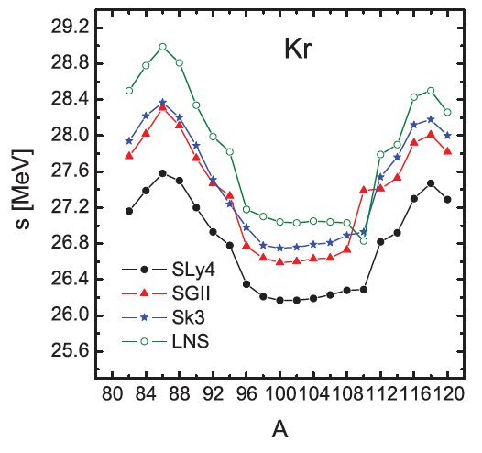
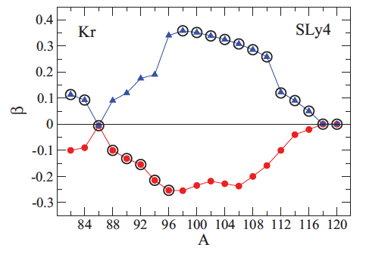
E_{sym} of deformed n-rich nuclei
Very neutron-rich Kr
Approach that combines deformed HF +BCS method with Skyrme-type density dependent eff. inter. and CDFM (Coherent Density Fluct Model)
Peak of E_{sym} semi magic ⁸⁶Kr (N=50) and ¹¹⁸Kr (N=82)
Reduction of Esym at maximum deformation whatever the interaction
prolate
Quadrupole parameter
oblate
M.K. GAIDAROV et al., PRC85, 064319 (2012)
Notes:
Theoretical approach that combines deformed HF +BCS method with Skyrme-type density dependent eff. inter. and CDFM. CDFM is an alternative way to make a transition from properties of nuclaer matter to properties of finite nuclei. BCS Bardeen –Cooper Schriefer method to have the pairing in the mean field
CDFM : coherent density fluctuation model (similar to RPA)
Calculation within CDFM : Coherent Density Fluctuation Model using the symmetry energy as a function of density within the Brueckner energy-density functional.
The nuclear deformation increases the surfaces area, thus leading to a larger surface energy in n-rich nucleus with deformed shape

Slide 14
Post-scission neutron multiplicities
Characterization in A and Z of FF is derived from the scission point model of B.D. Wilkins (PRC14, 1832, (1976)).
Assumption : the scission configuration is the one that minimizes the total energy of the FF
Derivative of Etot :
M. Caamaño et al., PRC88, 024605 (2013)

Slide 15
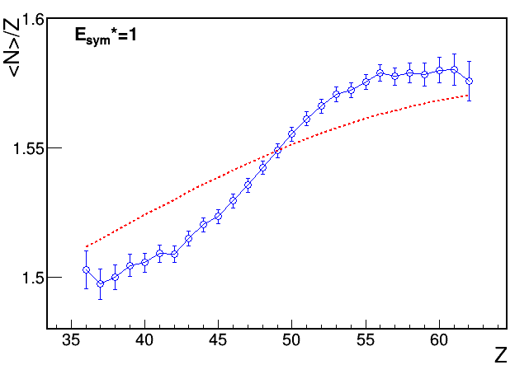
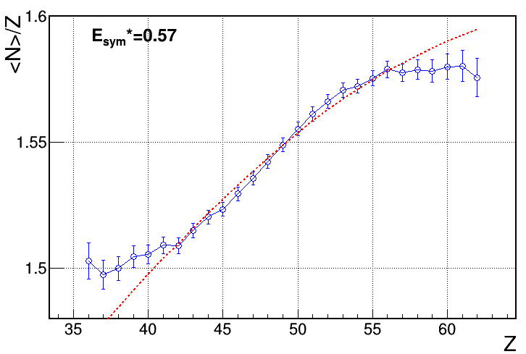
<N>/Z of fission fragments at the scission
Experimental Neutron excess before evaporation
E_{sym}
Comparison to Scission Point Model (LD) with standard Esym
with Esym*0.57
E_{sym} *0.57
Courtesy of F. Farget
Notes:
Je t'envoie deux figures de l'excès de neutron des fragments de scission (avant évaporation) du même système.
Les données expérimentales sont comparées au modèle du point de scission (goutte liquide) avec l'énergie de symétrie "standard" et diminuée d'un tiers.
La diminution de l'energie de symétrie avec la déformation est suggérée dans un papier de Gaidarov et al., PRC 85 (2012) 064319 que tu m'avais suggéré je crois.

Slide 16
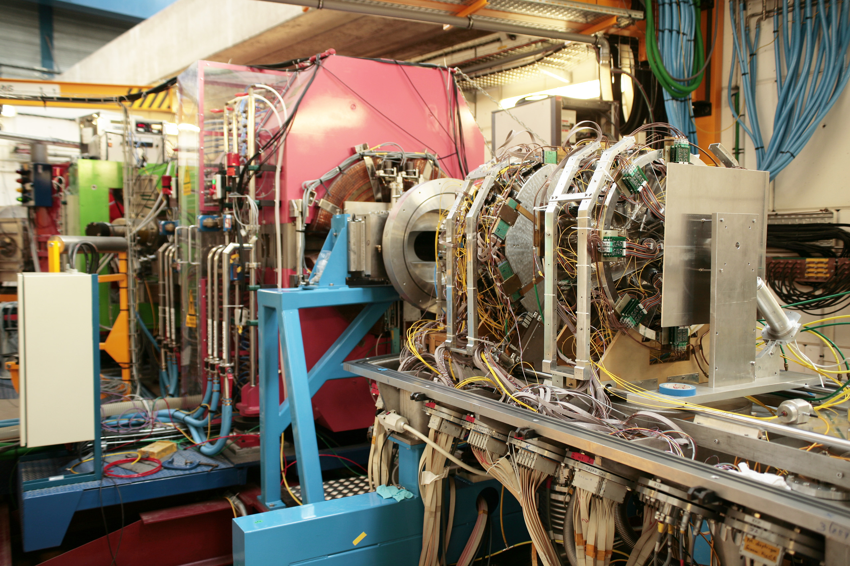
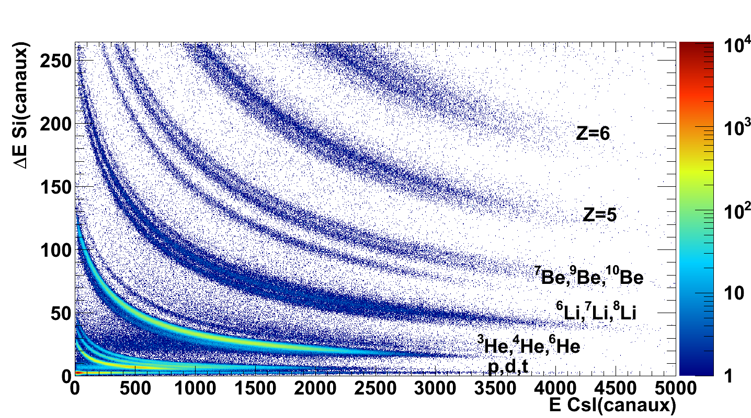
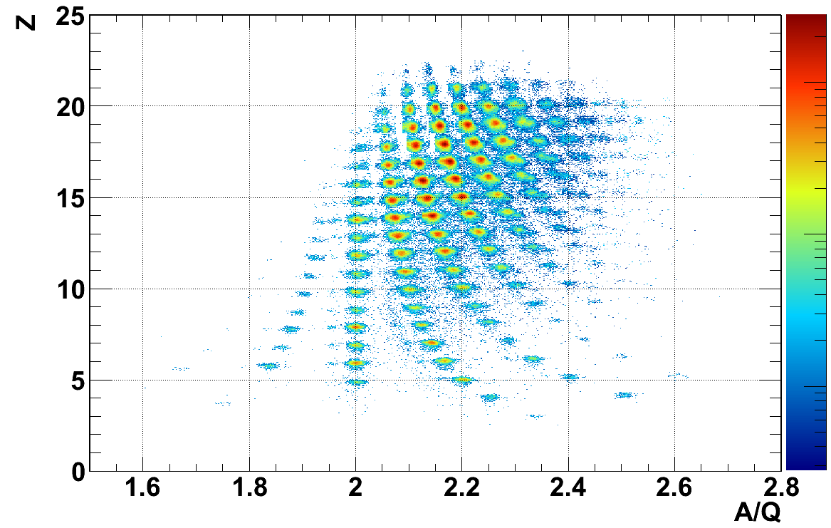
Q2
  VAMOS PLF (E503)
  High Isotopic Resolution
Symmetry energy experiments
⁴⁰Ca + ⁴⁰Ca @ E/A = 35 MeV
⁴⁰Ca + ⁴⁸Ca @ E/A = 35 MeV isospin diffusion
⁴⁸Ca + ⁴⁰Ca @ E/A = 35 MeV isospin diffusion
⁴⁸Ca + ⁴⁸Ca @ E/A = 35 MeV
For Bρ (Tm)= 2.2 , 2.12 , 1.957 , 1.80 , 1.656 , 1.523 , 1.401 , 1.289 , 1.186 , 1.091 , 1.004 , 0.923 , 0.849 , 0.782 , 0.719 , 0.661
Dipole
Q1
detection
INDRA
beam
  INDRA in coincidence LCP /IMF
  event characterization
  (b, excitation energy)

Slide 17
Isotopic distributions of PLF
& of reconstructed primary fragments
4040
4848
A_{PLF}
M. Boisjoli thesis Nov 2013
A.C et al., ARIS2014
A_{primary} - N_{free}
Derive an expression similar to Friedman adapted to more dissipative collisions

Slide 18


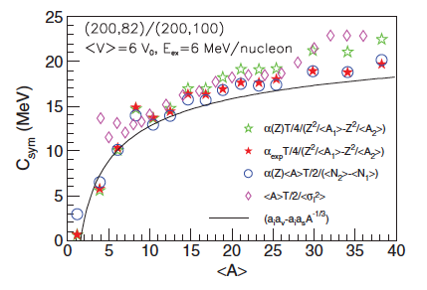

Prescription of A. Raduta & F.Gulminelli
In the framework of MMM
Csym directly inferred from width of Isotopic dist in Grand-canonical approximation
A Gaussian approximation on GC leads to
A. Raduta and F. Gulminelli, PRC75, 044605, (2007)

Slide 19
Conclusion
Study of E_{sym} in Fission with help of GEF allows to evaluate
  Effect of neutron evaporation on Esym
  Effect of deformation of n-rich nuclei on Esym
  Extraction of Esym from variance of ID
Application to more dissipative reactions (VAMOS+INDRA)
Work on progress…

Slide 21
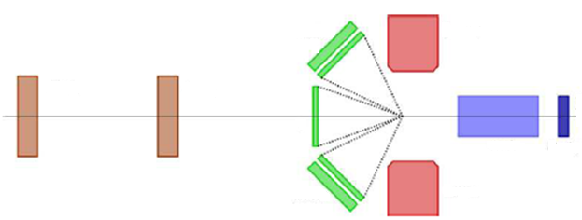
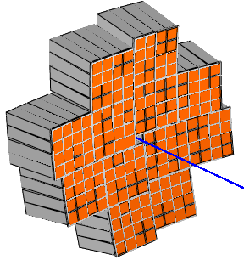
Possible setup
FAZIA/ 12 blocks (192)
2°-14°
Must2
⁵⁶⁻⁷⁰Ni
10⁵pps
50-35 A.MeV
Tracking detectors
(CATS)
Must2
14°- 58°
122°-166°
δ = (N-Z)/A = 0.2, for ⁷⁰Ni
δ = 0.0 for ⁵⁶Ni
Fazia 2°-14° : isotopic distributions of the PLF in coinc with LCP in Fazia and Must2 provide the primary isotopic distribution → E_{sym}, Isospin diffusion.
Must2 14°- 58° and 122°-166° (it covers the MR region (90° CM)) :
  correlation function for space-time characterization of sources
  estimation of the density around the projectile and MR
  In-medium short-lived nuclei as well as out-of-medium

Slide 22
Possible systems
Proj | 56Ni | 60Ni | 64Ni | 68Ni | 70Ni
δ = (N-Z)/A | 0 | 0.067 | 0.125 | 0.176 | 0.2
Target | 56Fe | 60Ni | 64Ni | 68Zn | 70Ge
δ = (N-Z)/A | 0.07 | 0.067 | 0.125 | 0.118 | 0.086
 |  |  |  |  | 70Zn
 |  |  |  |  | 0.143
Proj-target combination either very: n-rich or different asym n/z

Slide 23
GEF model http://www.cenbg.in2p3.fr/-GEF,354-
The model has been developed with the aim to provide dedicated nuclear data for applications in nuclear technology and engineering. The code treates spontaneous fission and fission up to an excitation energy of about 100 MeV (including multi-chance fission) for a wide range of heavy nuclei from polonium to seaborgium. The development of GEF has been supported by the European Union in the framework of the EFNUDAT and the ERINDA projects and by the OECD Nuclear Energy Agency. A detailed description of the code is given in this report .

